Slide 1

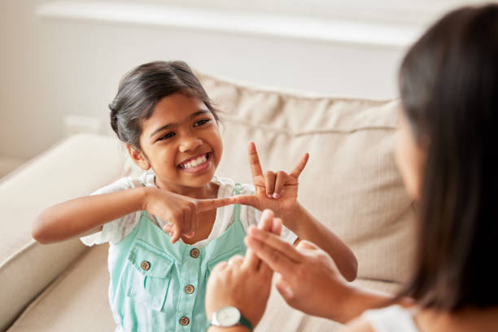
SIGN TO SPEECH CONVERTER FOR THE DUMB AND DEAF

Slide 2
PRESENTED BY
Shreya Sirsale – 21ET061
Samruddhi Kolapkar – 21ET033
Janhavi Pujare – 21ET054
Guided by
Dr. K. B.Chaudhari

Slide 3
CONTENT
Introduction
Problem Statement
Research
Circuit Design and Algorithm
Components
Methodology and Working
Expected Outcomes
References

Slide 4
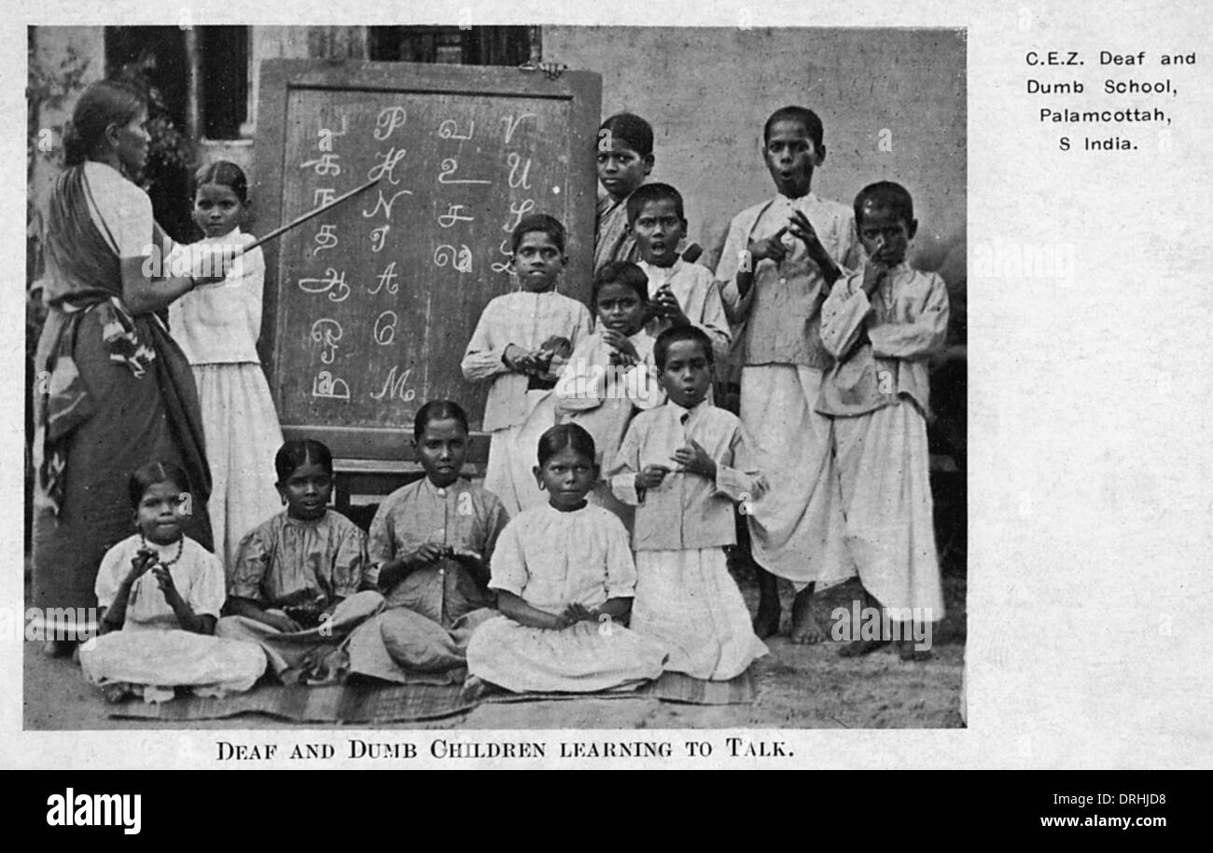
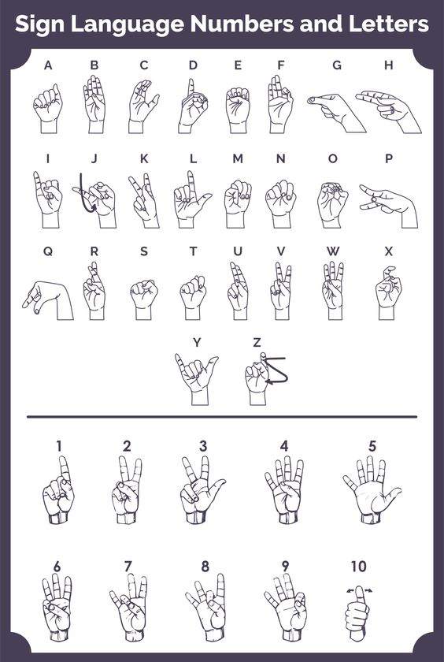
Introduction
Millions of people are deaf and dumb in India.
The intension of the gloves is to make the life style of the dumb and deaf people easy.
The system is working on a glove based device which will be used for conversion of sign language to speech.
The gloves translates the hand gestures to text and further speech so that the normal people can read and hear the gesture

Slide 5

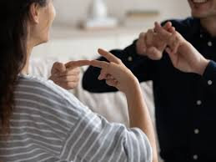
PROBLEM STATEMENT
The deaf and mute community face significant challenges while communicating with people who do not know sign language.
In such scenarios, bridging the communication gap becomes essential.
To address this issue, the development of a Sign Language to Speech Converter Message system is proposed.

Slide 6
RESEARCH
Thomas Pryor and Navid Azodi are UG students who made the Gloves that translate sign language into text and speech known as signaloud. They had won Lemelson-MIT student price for this project.
The 1st Hand Talk glove was designed by Ryan Patterson in the year 2001. This model had limitations that a computer or a laptop was always required for its functioning which made it less portable.

Slide 7
ALGORITHM
Circuit design
4

Slide 8
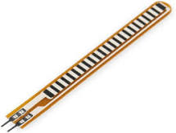
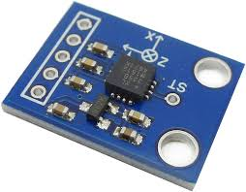
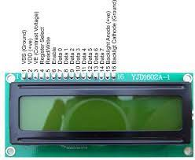
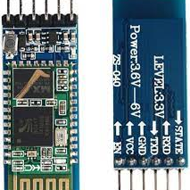
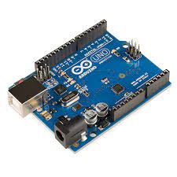
components
Bluetooth HC05
FLEX SENSOR
Accelerometer
Liquid Crystal Display
Arduino Uno

Slide 9
METHODOLOGY
STEP 1
The person wears the glove and makes the gesture according to the American Sign Language (ASL).
STEP 2
Arduino Uno is used to gather signals from the flex sensors and accelerometer placed on the glove.
The processed output is sent over the LCD to display the text output
STEP 4
The output is also sent via a Bluetooth link to an Android Smartphone or a PC consisting of test to speech software (application)
STEP 5
The speech output is obtained.
STEP 3

Slide 10
Working
The sign language gloves are stitched with 5 flex sensors over the thumb, index, middle, ring, pinky fingers on the hand.
Contact sensor and the accelerometer so recognize the exact movement of the fingers
The analog voltage obtained from the Flex sensors is then converted to digital voltage using Arduino Uno.
The Digital output is then compared with the preloaded values of sensor in the system for the Alphabets and numbers,
If the digital output matches the preloaded values then the recognition takes place of the Gestures and the compared output is given as a text output on the LCD.
Further the same output is transmitted over a Bluetooth module and then via Bluetooth link output is sent to android Smartphone or a PC having Bluetooth and TTS software.
The serial input is received via the Bluetooth link on the connected device and a text output is received on the application with speech output from the speakers.

Slide 11
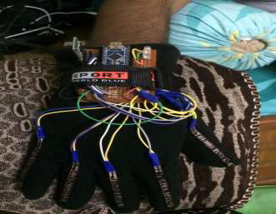
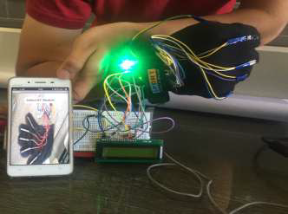
EXPECTED OUTCOME
Conversion of Sign gestures to a limited scope
Recognition of alphabets from A-Z and numerics from 0-9.
Displays of the output on a LCD screen
Sound output on the android Smartphone

Slide 12
REFERENCES
[1] http://lemelson.mit.edu/winners/thomas-pryor-and-navid- azodi.
[2] https://www.arduino.cc/en/uploads/Main/ArduinoNanoMa nual23.pdf
[3] https://www.sparkfun.com/datasheets/Sensors/Flex/flex22 .pdf
[4] http://www.in.techradar.com/news/wearables/These-gloves-literally-turn-sign-language-into-
speech/articleshow/51810332.cms
[5] http://www.ijste.org/articles/IJSTEV2I9089.pdf
[6] Solanki Krunal M, “Indian Sign Languages using Flex Senser Glove,” International Journal of
Engineering Trends and Technology (IJETT) - Volume4 Issue6- June 2013 ISSN: 2231
[7] http://www.statesymbolsusa.org/symbol-official-item/maine/state-language-poetry/american-sign-
language
[8] https://www.wionews.com/south-asia/how-do-we-speak-with-the-18-million-indians-who-
are-deaf-18835terpreters
[9] https://www.tinkle.in/tinkle-explains-sign-language-in-india/

Slide 13


